Slide 1


Slide 2


Slide 3



Team details
TEAM NAME: HoleSols IDEA NAME: Manhole Monitoring and Detection System
^{Photo} ^{V.V} |  | Aarush Raj Gandhari
Relangi Tarun Kumar (Team Leader)
College: Geethanjali College of Engineering and Technology Stream: CSE
Year of Graduation: 2026
College: Geethanjali College of Engineering and Technology Stream: AIML
Year of Graduation: 2026
V.R.Sai Sharanya
College: Geethanjali College of Engineering and Technology Stream: CSE
Year of Graduation: 2026

Slide 4
Problem Details
Domain | Public Safety Infrastructure
Problem Statement Title | HoleSols-Manhole detection and monitoring system
Problem Statement | Accidents on the road and deaths caused by manhole mishaps are often due to missing covers, improper coverage, partial coverage, and damaged manhole covers

Slide 5
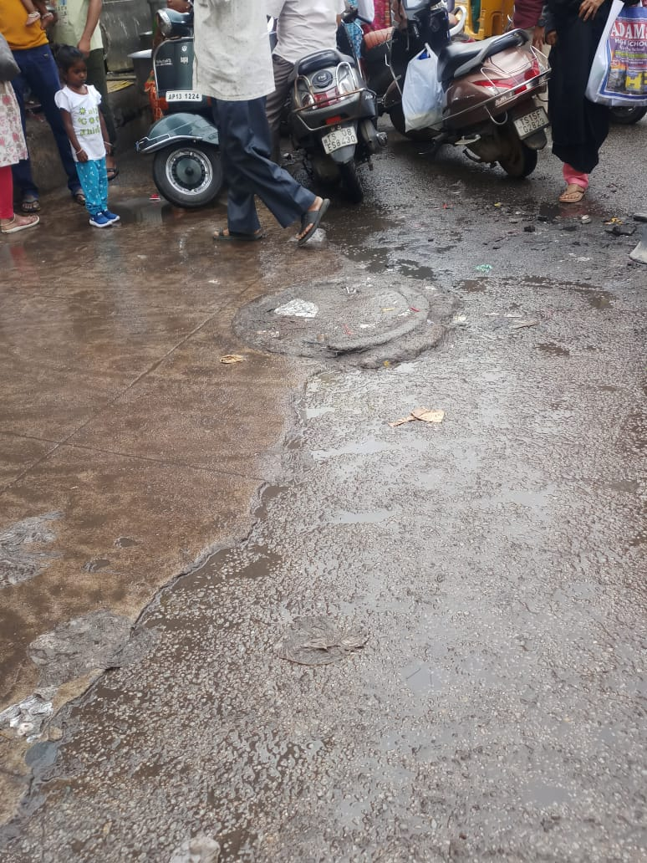
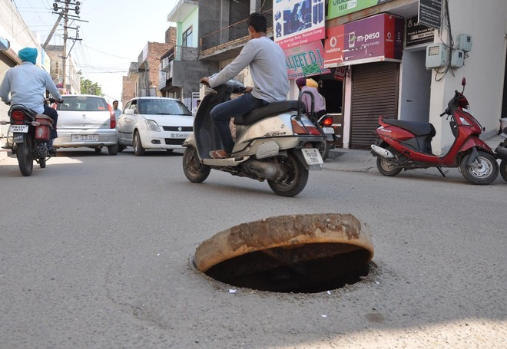



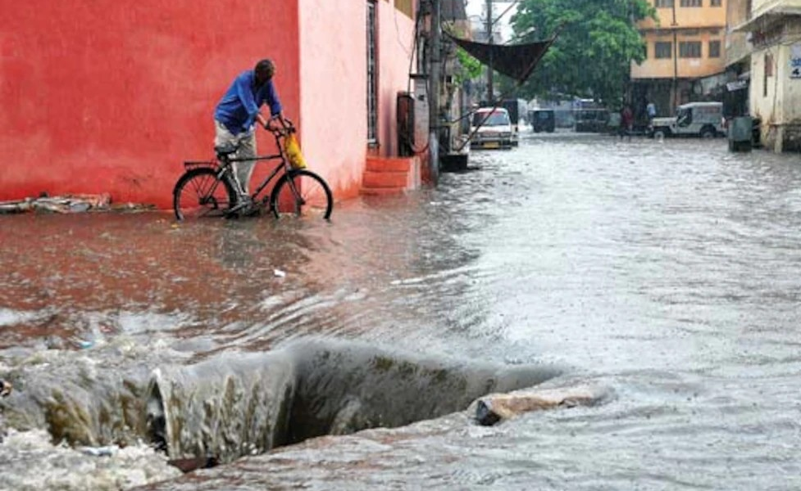
Problem Statement Motivation
https://ncrb.gov.in/
Date:12 August 2023, 14:50

Slide 6
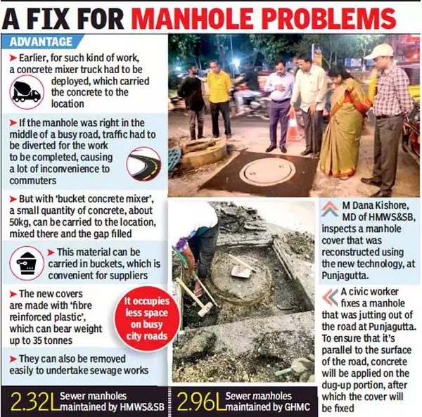
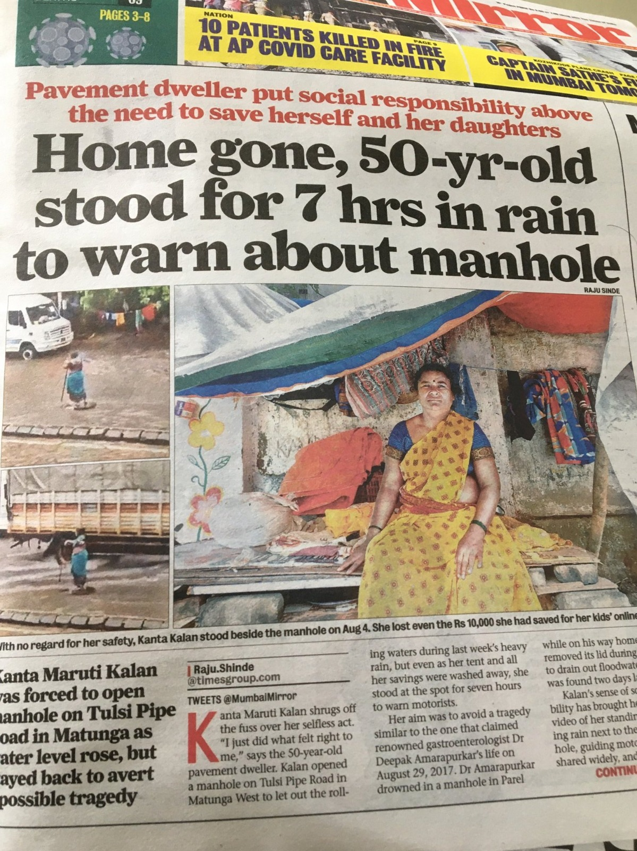
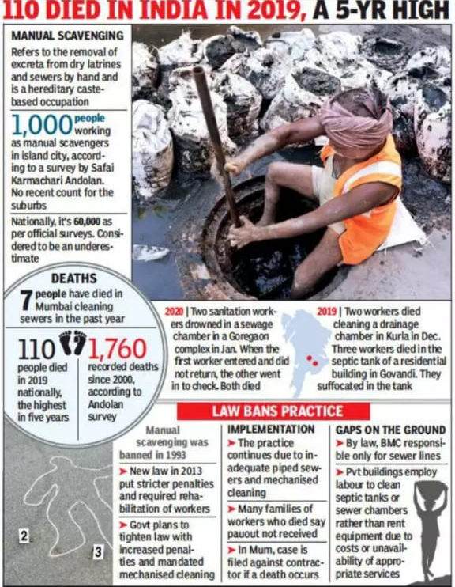
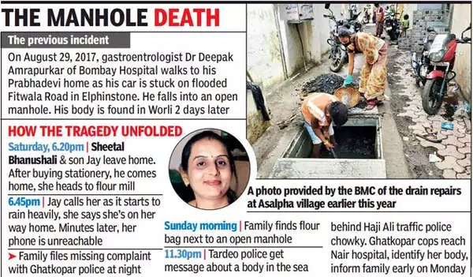
Problem Statement Validation
https://timesofindia.indiatimes.com/city/hyderabad/no-more-uneven-manholes-tech-to-make-ride-smoother/articleshow/67937270.cms
https://twitter.com/manukumarjain/status/1293186306810327041
https://images.app.goo.gl/JNCxo9ejmuKQFDNZA
https://timesofindia.indiatimes.com/city/mumbai/woman-falls-into-open-manhole-in-ghatkopar-body-found-in-worli-sea/articleshow/78503791.cms
https://ncrb.gov.in/

Slide 7
Describe the problem statement (200 words)
The problem of fatal open manholes is a preventable public safety problem that has claimed many lives and poses a significant threat to communities worldwide.
Open manholes on city streets pose a serious risk to pedestrians and drivers and require immediate attention to ensure public safety.
Open shafts refer to uncovered or poorly secured openings in the ground, usually located in streets, sidewalks, or other public spaces, designed to provide access to underground infrastructure such as sewers, water lines, or power lines.
This problem occurs when manholes are left open, improperly maintained, or inadequately marked, making them dangerous obstacles for pedestrians, motorists, and cyclists. Individuals can accidentally fall into these openings, resulting in serious injury, death, or long-term disability.
Inherently, the problem arises during rainfall leading to waterlogging. Difficulty in locating the blockage during rain pours causing overflow of rainwater on the roads
The consequences of open manholes that cause death are devastating and impact both the victims and their families. These incidents are often the result of improper maintenance, inadequate supervision, or inadequate safety measures.
Road accidents and deaths from shaft accidents (Number of accidents due to the manholes- At least 2 people die every day (5393 since 2015)) are often caused by missing manholes, improper covering, partial covering, and damaged manhole covers.
Open manholes causing death are a severe problem. When these holes in the ground are left uncovered or unmarked, people can fall and be injured or killed.

Slide 8
Solution Details
PROBLEM | SOLUTION
Missing manhole covers | IoT-based detector (vibration detector)
Broken and partial manhole cover | Alarm management system that sends signals to the sewage board
Lack of visibility | Alert system through light signal
Manhole Mishap | Notifications through the app
Open manholes | Temporary manhole coverage
Difficulty in locating the blockage during rain pours | Water Level Detection to prevent drainage overflow

Slide 9
Proposed solution / your big Idea (200 words)
This solution is an IoT device designed to improve wastewater management and public safety. This system has several important features:
IoT-based sensors: This system uses IoT sensors installed in the drain to monitor various parameters such as water level, and blockages. Sensors continuously collect data and send it to a central control center.
Alert Management: When an issue is detected, the system generates an alert. You can be immediately alerted about sewer conditions in your area and intervene to prevent sewer pipe failures and environmental damage.
Alarm system: In addition to notifying the sewer department, warning lights are placed in manholes to alert nearby pedestrians and drivers to slow down.
General Note: The system also includes a dedicated mobile application. Notifies residents when serious issues arise and ensures timely and safe updates.
Temporary manhole cover: To ensure the safety of public accidents can be prevented by sending temporary manhole covers during the monitoring period.
Manhole cover guide: This is an application that allows passengers to quickly evacuate the location in the event of an emergency. To prevent this, a real-time map of manhole cover locations is included.
The solution integrates the Internet of Things, artificial intelligence, and communications technologies to improve wastewater management, improve public safety, and reduce environmental risks.

Slide 10
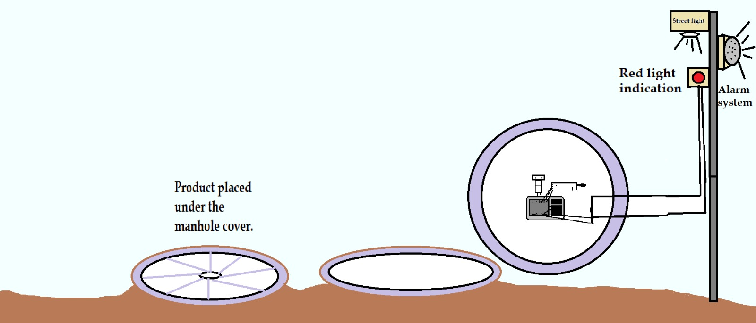
Proposed Solution Concept

Slide 11
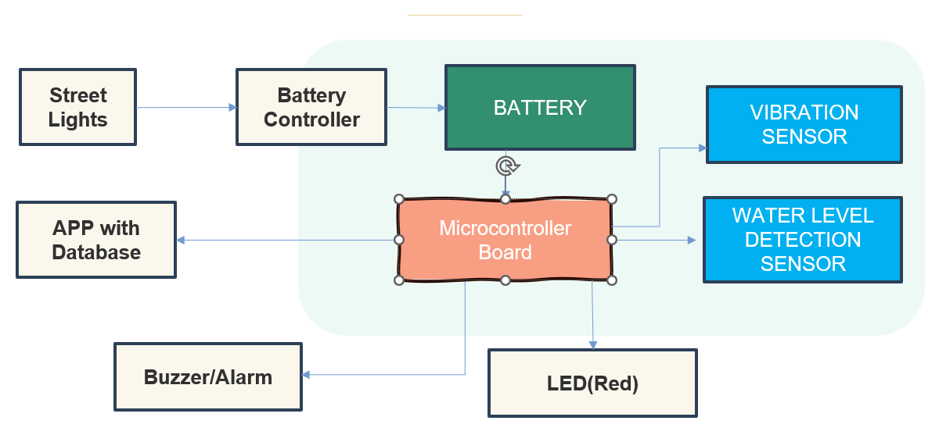
Proposed Solution Block Diagram

Slide 12
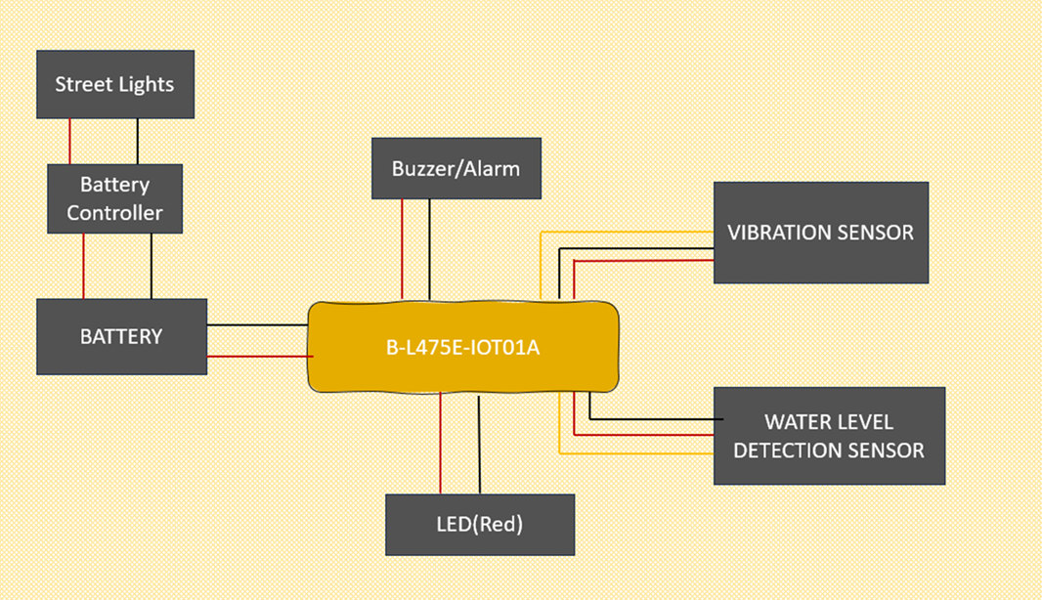
Proposed Solution Circuit Diagram
Microcontroller
Board

Slide 13
How does your innovation accelerate change with the power of Technology?
(200 words)
Our innovations are revolutionizing many important ways by harnessing the power of technology:
Real-time monitoring: Through IoT sensors and Smart hosts, our solutions provide real-time information about wastewater. This ensures proper monitoring and rapid response to problems,
reducing the risk of wastewater failure and environmental pollution.
Alarm: The system has the ability to raise an alarm and send a signal to the Sewerage Department and the
public, allowing rapid intervention in emergency situations. This performance reduces response times and
increases security.
Public participation: Thanks to integration with mobile applications, our innovations are presented directly to the public during the monitoring and notification process. This not only provides people with important
information but also raises awareness of community involvement in wastewater management.
Safety Precautions: The system uses alert lights and temporary manhole covers to increase underground
safety and reduce wastewater-related accidents and injuries.
Geographic Awareness: Geographic manhole indicators assist urban planning and property management
by providing manhole location information, and supporting optimization of wastewater layouts.
Together, our innovations use technology to create smarter, safer, and more efficient wastewater management.
It enables positive change by preventing environmental degradation, improving public safety, and engaging
communities in the maintenance of critical infrastructure.

Slide 14
How is your solution different/unique from other solutions in market (150 words)
The ability to simplify installation and maintenance while combining advanced wastewater and safety
technologies.
Unlike traditional systems that require structural modifications, our solutions feature easy installation and
reduce the impact on the existing sewer system.
Wireless communication simplifies maintenance and reduces the need for physical inspection.
failure and damage to the environment.
Notification function: The system provides various notification methods such as alerts and push
notifications to inform parties in unusual or emergency situations.
Realtime monitoring: This feature ensures that problems occur immediately, allowing rapid
prevention of sewer.
Reporting, forecasting, and optimization: Monitoring capabilities generate reports, predict problems, boost performance, and improve business.
Light Indicators: Good lighting increases visibility and safety around manholes, reducing accidents for
pedestrians and drivers.
Partial Manhole Cover: During maintenance or in emergencies, the system can be installed with temporary
covers to further increase safety.

Slide 15
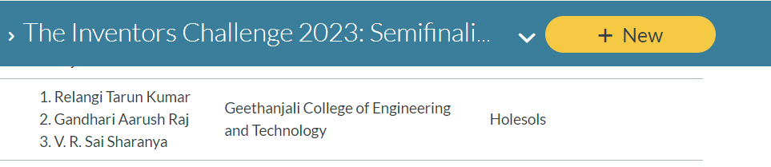
Testimonials received
PATENT FILED: No, It will be filed once the POC/technology is done.
Working model/prototype
We have not done the working model/prototype right now.
We will be able to provide the working model once the Proof of Concept is technically verified.
We are one of the Semifinalists in the Inventors Challenge 2023
https://community.arm.com/the-inventors-challenge-2023/b/announcements/posts/the-inventors-challenge-semifinalists-details

Slide 16


Thank you!

